Slide 1
MultiCon Multilayer Concordance Functions in ELAN and ANNEX
Onno Crasborn
Centre for Language Studies
Radboud Universiteit, Nijmegen
CLARIN-NL, Hilversum, 6 March 2012

Slide 2
Onno Crasborn Han Sloetjes
Lari Lampen
Micha Hulsbosch
Project coordinator Developers
& User

Slide 3
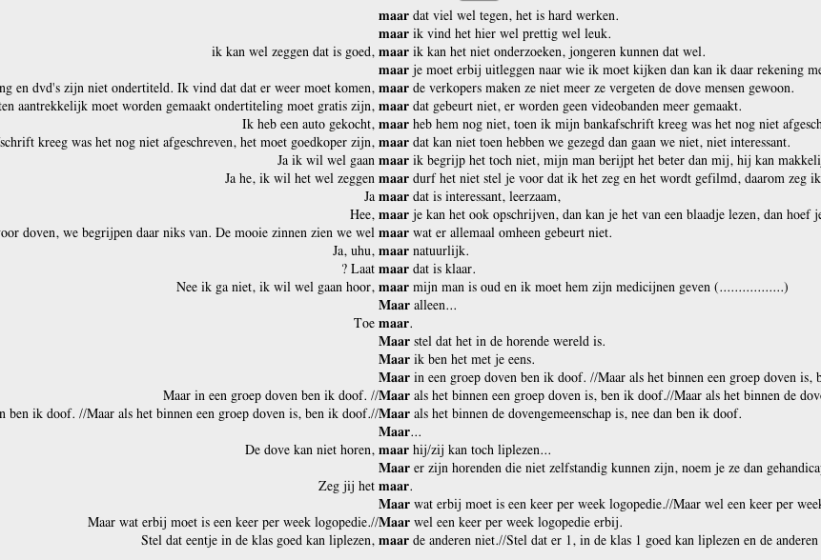

Slide 5
Spoken language
Segmental string
Intonation
Hand movement
Eye gaze
Eye brows
Head movement
…

Slide 6
Sign language
Left hand
Right hand
Eye gaze
Eye opening
Eye brows
Cheeks
Nose
Mouth
Head
Torso

Slide 7
Sign language
Left hand
Right hand
Eye gaze
Eye opening
Eye brows
Cheeks
Nose
Mouth
Head
Torso

Slide 8
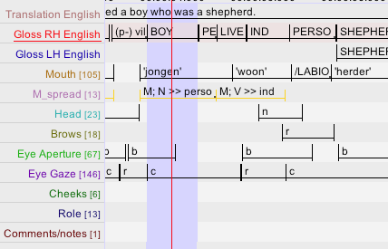

Slide 9
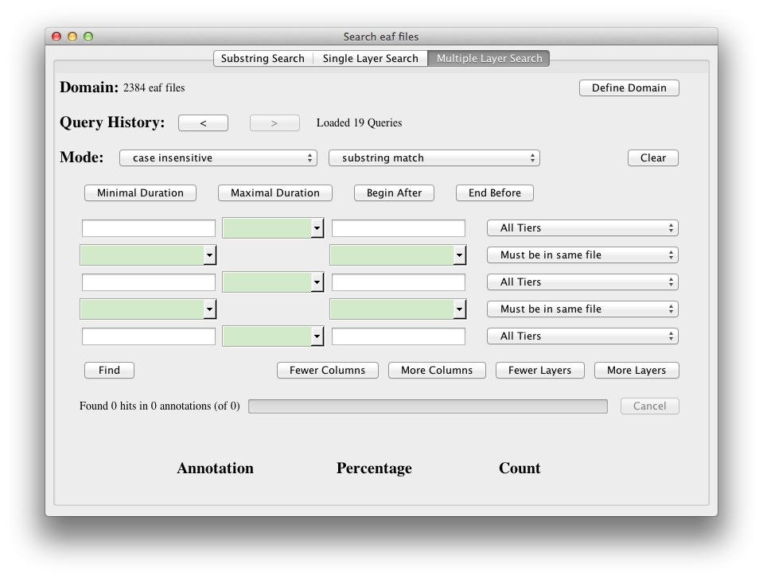

Slide 10
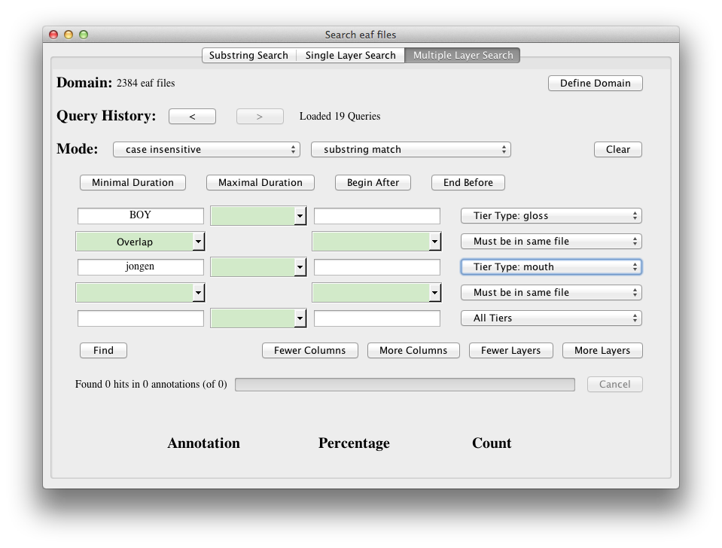

Slide 12
Goals for MultiCon
Enable query by variable (rather than a string/RegExpr)

Slide 13
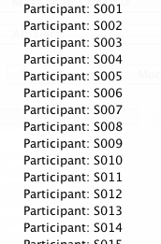
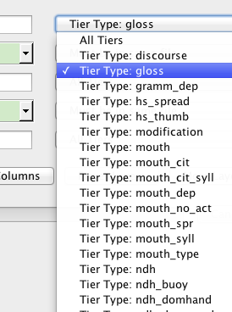
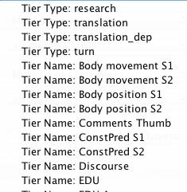
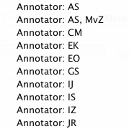

Slide 14
Goals for MultiCon
Enable query-by-variable (rather than a string/RegExpr)
Enable queries specifying multiple criteria

Slide 16
Goals for MultiCon
Enable query-by-variable (rather than a string/RegExpr)
Enable queries specifying multiple criteria
Enable saving of queries

Slide 17
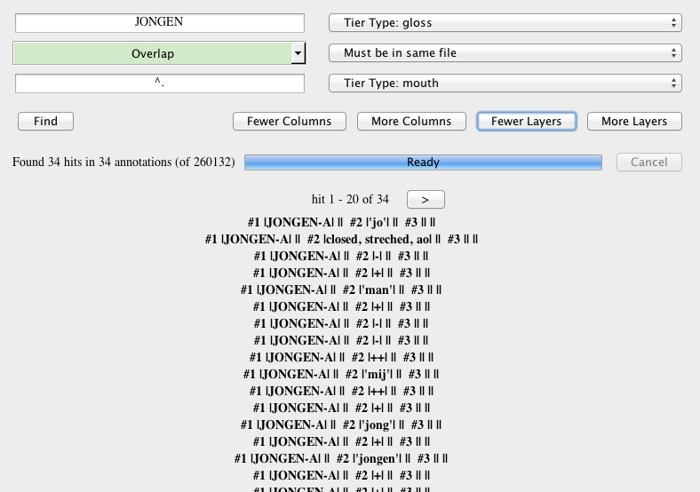

Slide 20
Filename
Participant
Annotator
Filename
Participant
Annotator

Slide 21
Goals for MultiCon
Enable query-by-variable (rather than a string/RegExpr)
Enable queries specifying multiple criteria
Enable saving of queries
Visualisation of collocations in search results
Integrate these in both ELAN and ANNEX
Disseminate through webcasts of the new functionality

